Slide 1
Finance analysis package using Yahoo Finance data
By Lawrence Ray

Slide 2
Yfinance 0.1.67 in python
Open-source platform available on github
It pulls financial data from Yahoo Finance
Data manipulation for the open market/extended market
Including Dow Jones Industrial Data
Cryptocurrency
General Companies stocks
Currency Comparison

Slide 3
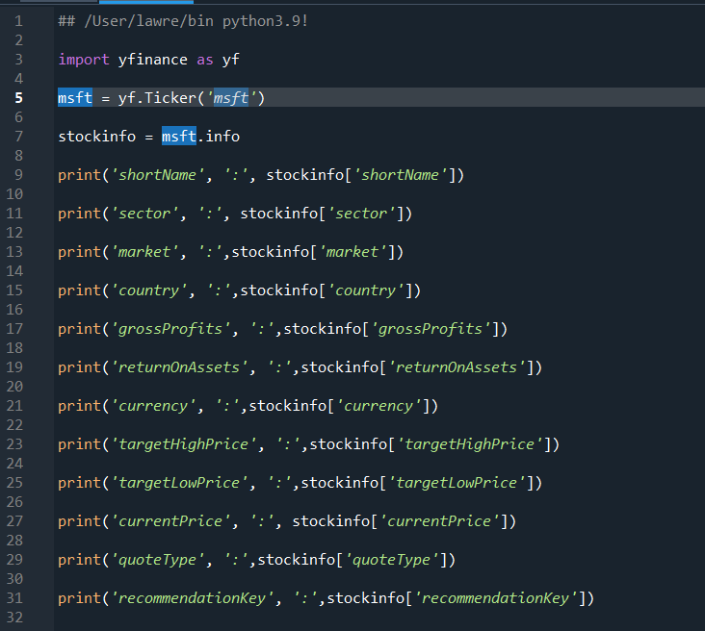
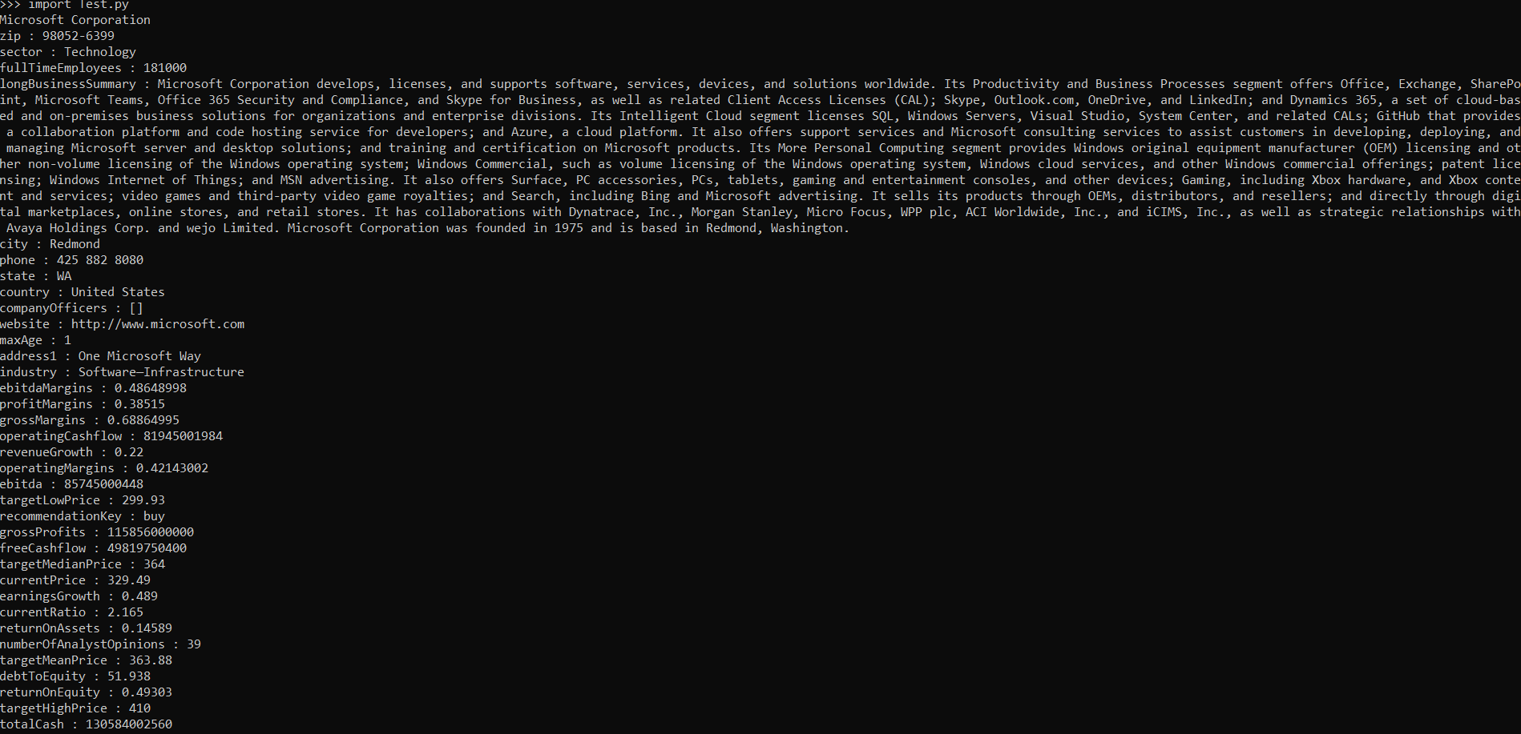
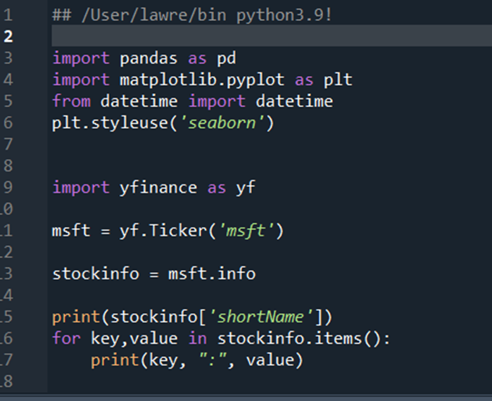
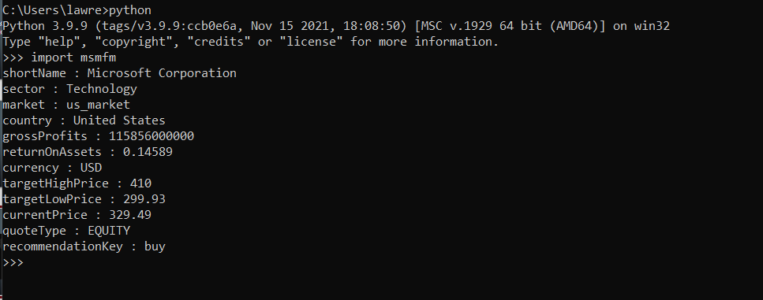
Pulling stock Data

Slide 4
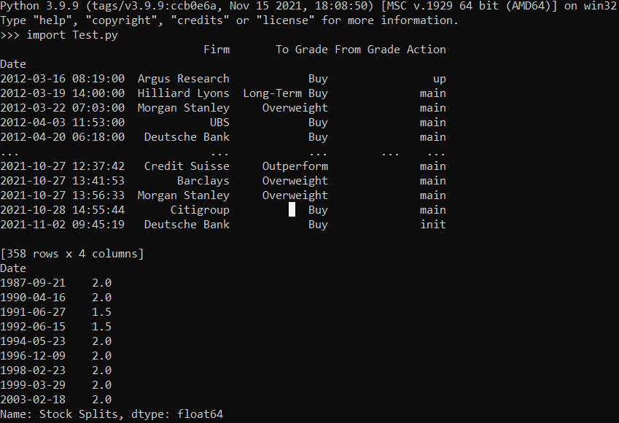
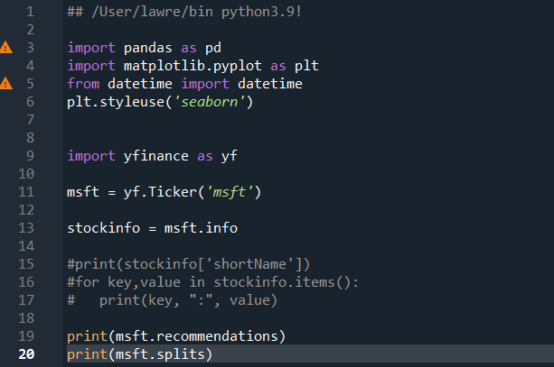
Stock Splitting history

Slide 5
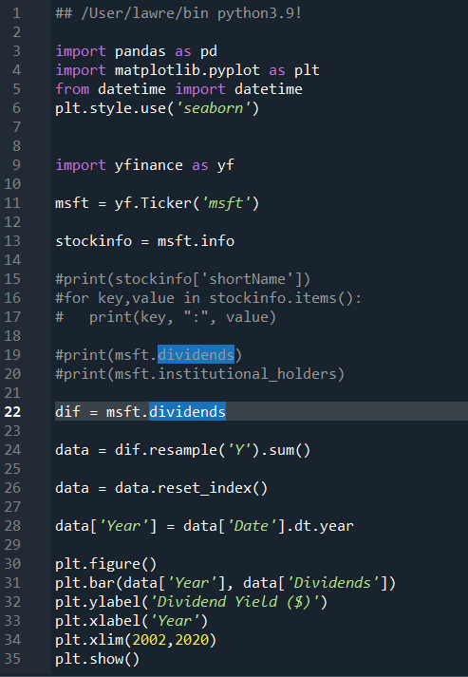
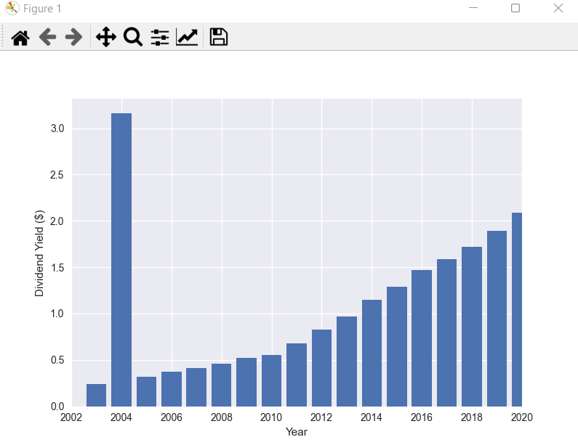
Dividend pay-outs

Slide 6
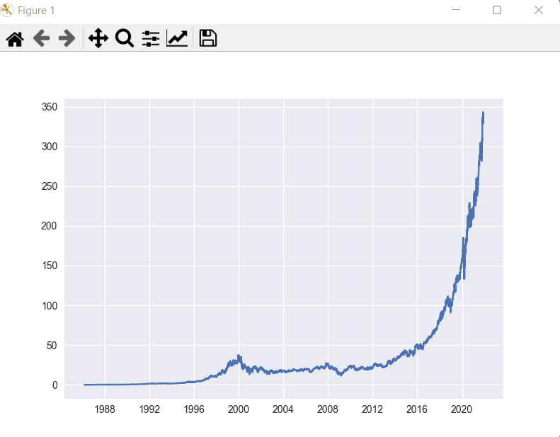
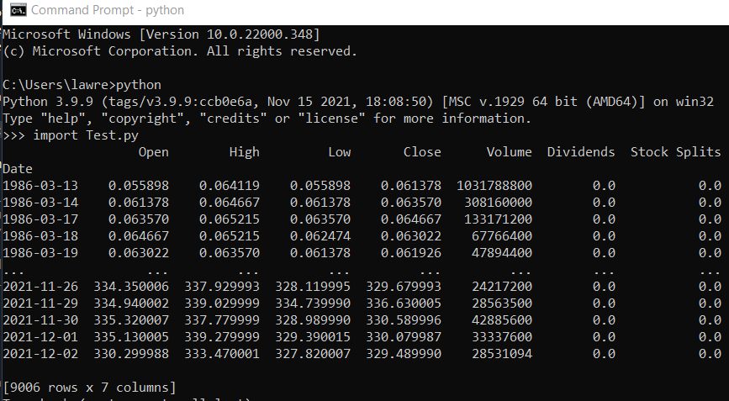
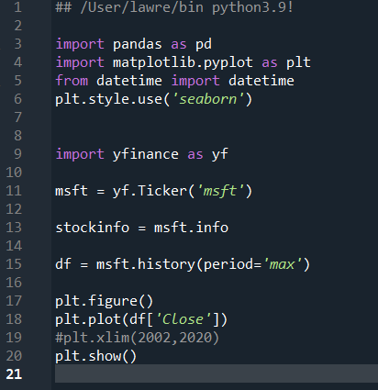
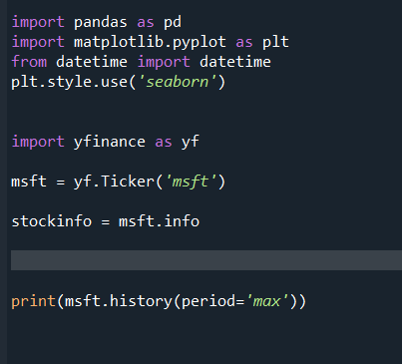
Price History

